Slide 1

Summer Internship Presentation ON Generative adversarial network
Presented by
Dileep Singh
(23AG65R01)
Department of Agricultural & Food Engineering
Indian Institute Of Technology Kharagpur

Slide 2
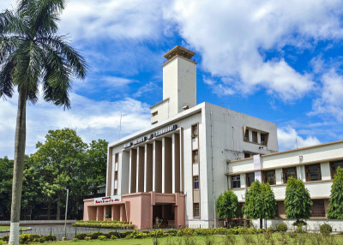
Internship Overview
Name of the Organisation: Department of Agricultural and Food Engineering, Indian Institute of Technology Kharagpur
Title of the work: Development of GANs of generating Image
Name of the Internship Supervisor: Prof. Subhadip Dey
Duration: 01 June,2024–10 July,2024

Slide 3
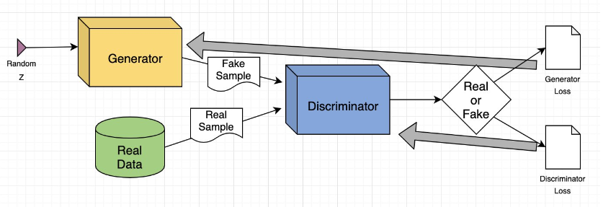
GANs
Generative Adversarial Networks(GANs) are a powerful class of neural networks that are used For an unsupervised learning. GANs are made up of two neural networks, a discriminator and a generator. They use adversarial training to produce artificial data that is identical to actual data.

Slide 4
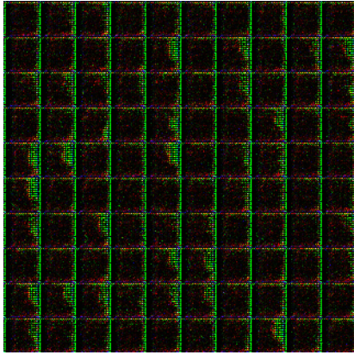
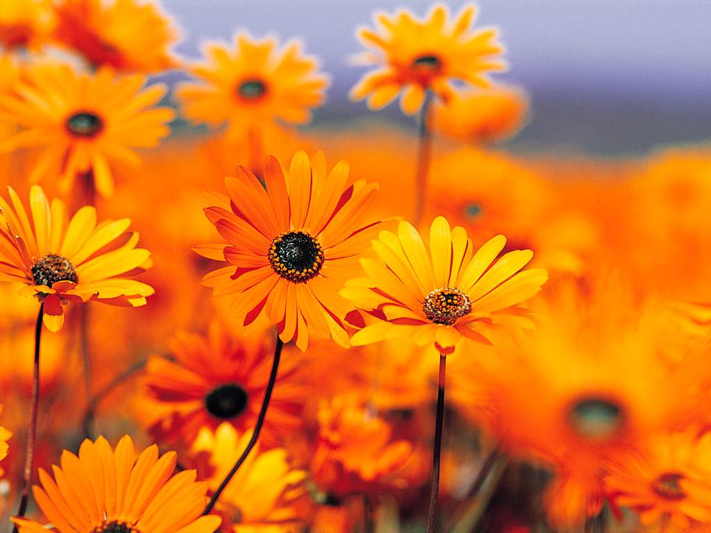
GANs Architecture
Generator
Fake Image
FAKE OR REAL
Discriminator
Noise
CONV2DTranspose layers
Real Image
CONV2D Layers

Slide 5
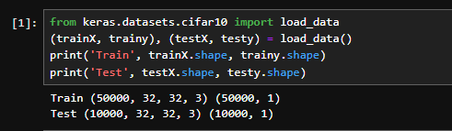
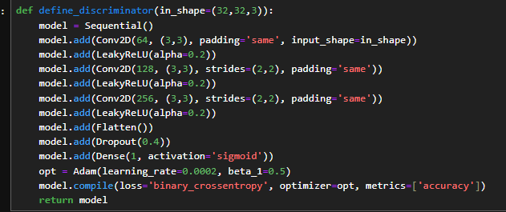
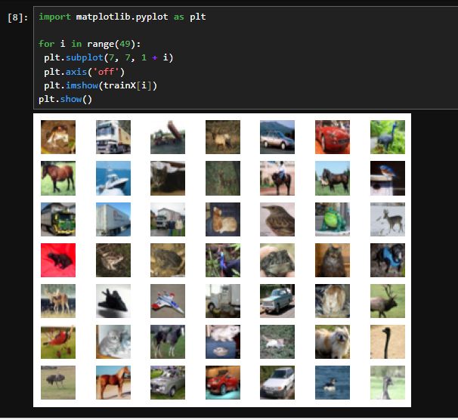
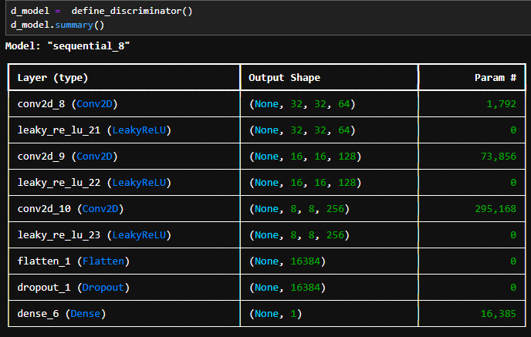
Training of GANs
Discriminator

Slide 6
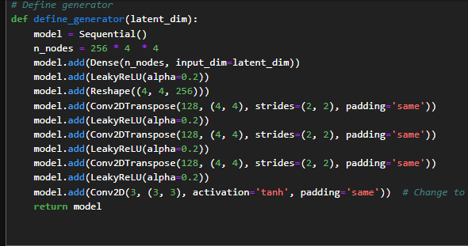
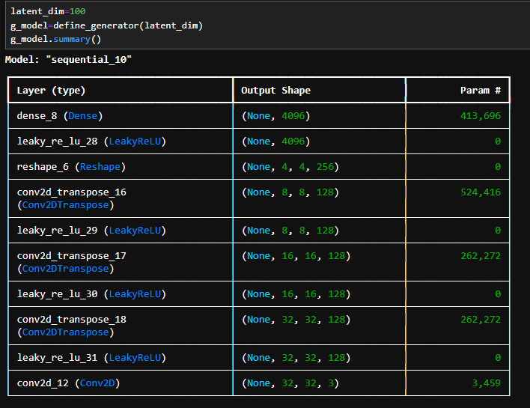
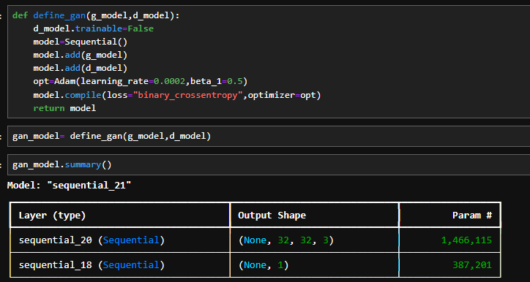
Generator model
Combine Both Generator and Discriminator

Slide 7
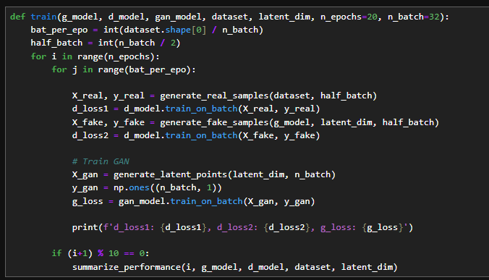
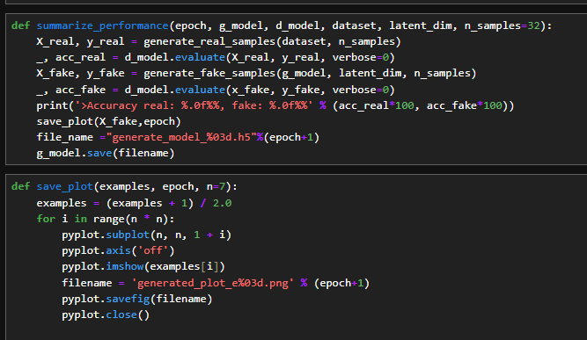

Slide 8
Application of generative adversarial network in Aquaculture
Species Identification:- GANs can enhance the quality of underwater images, making it easier to identify and monitor fish species. This is particularly useful for automating the process of species identification in large-scale aquaculture operations.
Image Inpainting:- For underwater imaging, GANs can fill in missing or corrupted parts of an image, such as areas obscured by turbidity, helping in the accurate assessment of water quality and fish health.
Cloud Removal: GANs can be applied to remove clouds from satellite images, a significant issue in optical remote sensing. This can
Super-Resolution: GANs can be used to enhance the resolution of satellite images, making it possible to detect smaller objects or finer details that are crucial for environmental monitoring, including aquaculture activities. improve the accuracy of land and ocean surface monitoring.
Chlorophyll Prediction: GANs can predict chlorophyll concentrations from satellite images, helping in the early detection of algal blooms. This is crucial for preventing harmful algal blooms that can devastate aquaculture operations.

